Slide 1

Expansion Scope
BY
MR. ShELDON lUIS dE NORONHA
24-05-2024

Slide 2
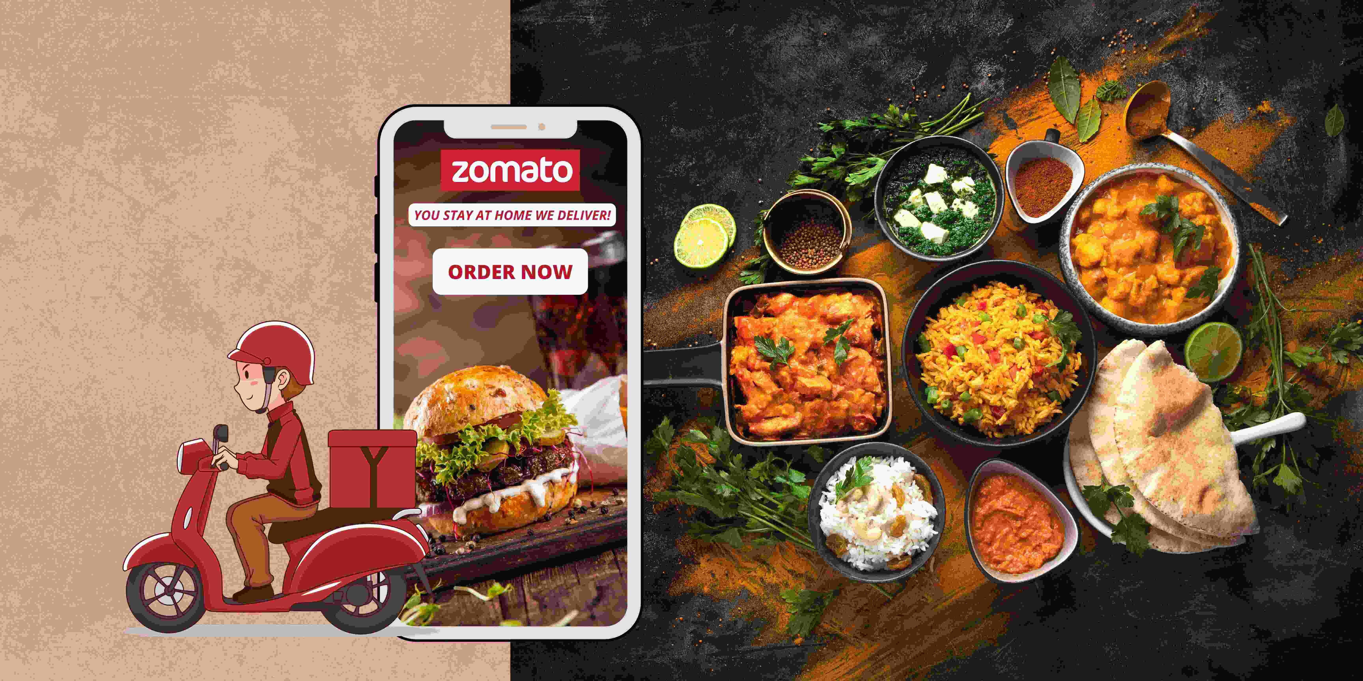
ABOUT ZOMATO
Launched in 2010, Our technology platform connects customers, restaurant partners and delivery partners, serving their multiple needs.
Customers use our platform to search and discover restaurants, read and write customer generated reviews and view and upload photos, order food delivery, book a table and make payments while dining-out at restaurants.
On the other hand, we provide restaurant partners with industry-specific marketing tools which enable them to engage and acquire customers to grow their business while also providing a reliable and efficient last mile delivery service.
We also operate a one-stop procurement solution, Hyperpure, which supplies high quality ingredients and kitchen products to restaurant partners. We also provide our delivery partners with transparent and flexible earning opportunities.

Slide 3



Data Summary
Total Number Of Restaurant
9542
Total AVG. Rating
2.89034793544331
Total Number Of Voters
1495919
Total Sum Of AVG. Cost For Two
11461164
This data helps to build a understanding the current food market of different regions of different countries across the globe.
Data Cleaning and pre-processing output
The data was cleaned of missing values and replaced date column sign ‘_’ with ‘-’ for getting year.
Unified the price with currency abbreviation/symbol into a customised column.
The name of the country was introduced according to country for better cross - reference.
This country based restaurant data is crucial for current market analysis of current cuisine trend, customer preference, competitor analysis and restaurant performance analysis.
Insights for expansion is greatly dependent on the user preference and competition on particular countries.

Slide 4



Data cleaning – Deleted missing values data rows as it was less than 5% of the data and removed duplicates to ensure data accuracy.
Data enrichment – Data was enhanced by using xlookup function for country name and customized price column for cross reference with the external data sources.
Descriptive analysis – Pivot table’s were used to summarize the data for understanding the cuisine and year trend in the ongoing market of regions of different countries, along with the big competitors data of specific regions of different countries.
Customer preference analysis – Conducted cuisine based customer analysis in different regions of different countries using the avg. Rating.
Restaurant performance analysis – Used rating and average cost to make an overview of performance for restaurants of different regions of different countries.
Visualization – Dynamic charts and dashboard are created for user interaction with data exploration.

Slide 5

Country | Count of RestaurantID
Canada | 4
Qatar | 20
Singapore | 20
Sri Lanka | 20
Indonesia | 21
Philippines | 22
Australia | 24
Turkey | 34
New Zealand | 40
Brazil | 60
South Africa | 60
United Arab Emirates | 60
United Kingdom | 80
United States of America | 425
India | 8652
Grand Total | 9542
Country | Average of Votes
Indonesia | 772.0952381
United Arab Emirates | 493.5166667
Turkey | 431.4705882
United States of America | 430.8752941
Philippines | 407.4090909
South Africa | 315.1666667
New Zealand | 243.025
United Kingdom | 205.4875
Qatar | 163.8
Sri Lanka | 146.45
India | 137.212552
Australia | 111.4166667
Canada | 103
Singapore | 31.9
Brazil | 19.61666667
Grand Total | 156.7720604
Year | Count of RestaurantID
2010 | 1079
2011 | 1096
2012 | 1022
2013 | 1059
2014 | 1049
2015 | 1023
2016 | 1026
2017 | 1086
2018 | 1102
Grand Total | 9542
The maximum number of restaurant are mostly present in the country India and United States of America i.e. there will be higher competitions.
HOWEVER CANADA has the least number of restaurants hence would be a good country to enter the market.

Slide 6
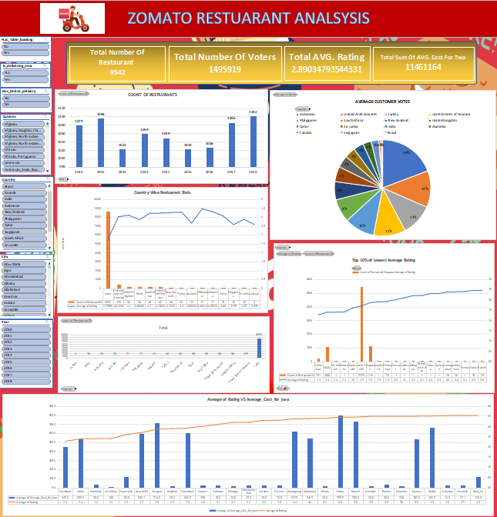

The Dashboard gives an overview of all the Info needed to further analyse data as well as have some indepth analysis provided.

Slide 7

Avg. Of voters helps us to understand in which country number of customer is the highest and lowest.
The number of average voters are the highest in Indonesia, Philippines, Turkey, United Arab Emirates and United States of America.
Singapore and Brazil has the lowest number of avg. Voters.
Country | Average of Votes
Indonesia | 772.0952381
United Arab Emirates | 493.5166667
Turkey | 431.4705882
United States of America | 430.8752941
Philippines | 407.4090909
South Africa | 315.1666667
New Zealand | 243.025
United Kingdom | 205.4875
Qatar | 163.8
Sri Lanka | 146.45
India | 137.212552
Australia | 111.4166667
Canada | 103
Singapore | 31.9
Brazil | 19.61666667
Grand Total | 156.7720604

Slide 8

Recommended Countries For Expansion:-
Selection Criteria –
Sum of average cost for two “< 650.
Average rating < 3.
Count of restaurant less than 50
Countries
India
United States of America
Australia
Canada
As per our data we can expect to have a higher chance of success in these countries as they satisfy the price range and also has a low competitor market.
Online delivery can bring a greater impact to these countries as they do not have any online food delivery services.

Slide 9
States Data Suitable For Expansion:-
Montville
Mc Millan
Paynesville
Mayfield
Ghaziabad
These locations has Rating Less than 3 and also have a Low Number of Restuarants which inturn means ‘less competition’.
The Lower the rating indicate a good market to advance and target satisfactory consumers and also low Number means less compitetion.

Slide 10

Recommended Cuisines
American, Asian, Burger
American, BBQ, Sandwich
American, Desserts
American, Desserts, Steak
American, Sandwich, Salad
American, Sandwich, Tea
American, Seafood, Sushi
American, Southern, Southwestern
BBQ, Burger, Desserts
BBQ, Caribbean, Seafood
Brazilian, Steak
Breakfast, Mexican
British, Bar Food, Sandwich
Burger, Bar Food, Steak
Burger, Sandwich, Seafood
Cajun
Cuban, Spanish
Desserts, Bar Food
Desserts, Bí-rek
Hawaiian
Hawaiian, Seafood
Hawaiian, Seafood, Steak
Indian, Continental
Indian, Rajasthani
International, Italian, Southern
Italian, Deli
Latin American, Mexican, Southwestern
Mexican, Vegetarian
New American, Tapas
Pub Food
World Cuisine, Patisserie, Cafe
Cuisines for Recommended city Expansion having low ratings and low AVG Cost FOR 2
City | Cuisines
Mc Millan | Breakfast, Burger
Montville | Coffee and Tea, Modern Australian
Paynesville | Modern Australian
Mayfield | Asian
Ghaziabad | Chinese
Ghaziabad | Ice Cream
Ghaziabad | North Indian
Ghaziabad | North Indian, Chinese
Ghaziabad | North Indian, Chinese, Continental
Ghaziabad | North Indian, Mughlai

Slide 11

Conclusion
Customer response – Analyzed customer preference and rating affecting the restaurant based on cuisine, ratings and Avg Cost For 2
New market penetration – The top competitors has been identified, along with the lowest rated restaurant in those suggested countries.
Pattern analysis – Relation between Ratings and Average Cost for 2, if there is a correlation betwenn the 2
“Our statistical analysis gives an overall view of impact according to the decision. The customer satisfaction, cuisine related rating increase or decrease gives us an insight how to increase market share of Zomato across the globe. The suggestion made were just not speculations it’s based on careful analysis of trend and behavior as well the location impact on the business. This gives us an edge for a successful business expansion”.

Slide 12

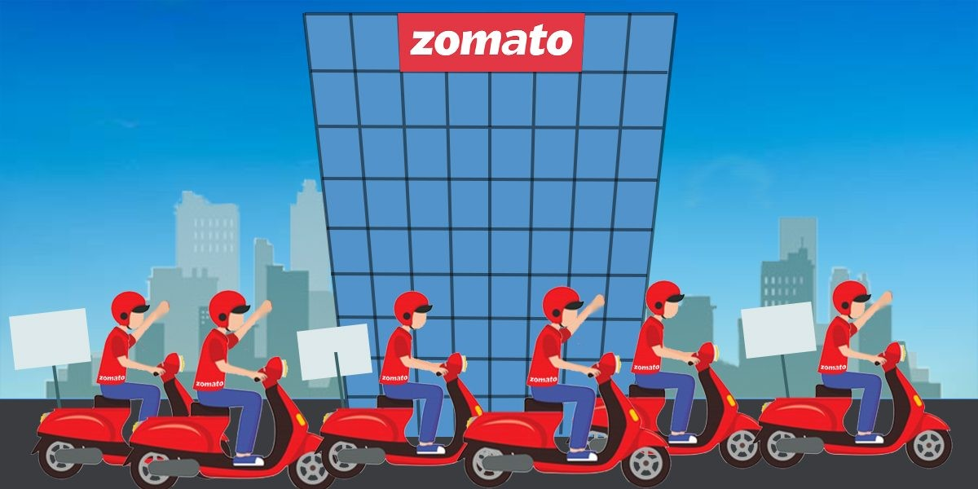
Suggestion:
l From the above data we consider the Countries that satisfy - High Count and Low Avg Rating (Although the competition is High and Consumers are not satisfied hence there can be possible room for business and expansion) e.g.
Country | City | Average of Average_Cost_for_two | Average of Rating | Count of RestaurantID
India | Faridabad | 447.6 | 2.3 | 251
India | Noida | 539.5 | 2.4 | 1080
India | New Delhi | 596.1 | 2.7 | 5473
India | Gurgaon | 714.0 | 2.9 | 1118
l We will also consider Countries that satisfy -Low Count and Low Avg Rating, as this would be a perfect scenario to enter and capture the market.

